Slide 1

Mastering CarRacing-v0 and Snake Game using Off-Policy Deep Reinforcement Learning Algorithms
Nurullah Sevim
Furkan Burak Mutlu

Slide 2
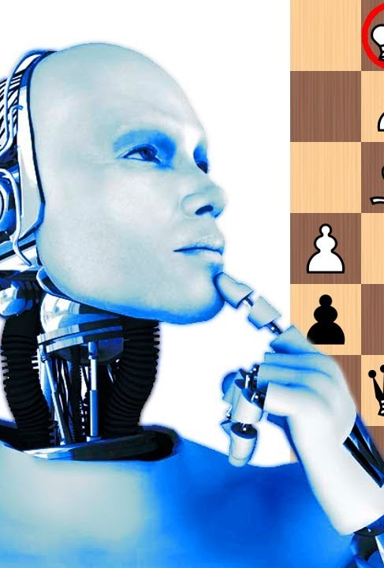
Reınforcement learnıng
Reinforcement learning (RL) studies how an agent interacts with its environments to learn a good policy by maximizing the cumulative sum of delayed rewards.
This field gained a considerable attention in recent years.
Combined with deep learning, Reinforcement learning agents can control continuous systems, achieve superhuman level performance in board games or video games.
L.-J. Lin, “Self-improving reactive agents based on reinforcement learning, planning and teaching,” Machine learning, vol. 8, no. 3-4, pp. 293–321, 1992.
R. S. Sutton, “Learning to predict by the methods of temporal differences,” Machine learning, vol. 3, no. 1, pp. 9–44, 1988.
V. Mnih, K. Kavukcuoglu, D. Silver, A. Graves, I. Antonoglou, D. Wierstra, and M. Riedmiller, “Playing atari with deep reinforcement learning,” arXiv preprint arXiv:1312.5602, 2013.
H. Van Hasselt, A. Guez, and D. Silver, “Deep reinforcement learning with double q-learning,” in Proceedings of the AAAI conference on artificial intelligence, vol. 30, no. 1, 2016.

Slide 3


Methodology
We used two Off-Policy algorithms for two environments
PER-DDQN for Snake Game (Discrete)
TD3 for CarRacing-v0 (Continuous)
In Snake Game environment, we extracted the features with CNNs
CarRacing-v0 environment, provides necessary information
OpenAI, “Openai five,” https://blog.openai.com/openai-five/, 2018

Slide 4
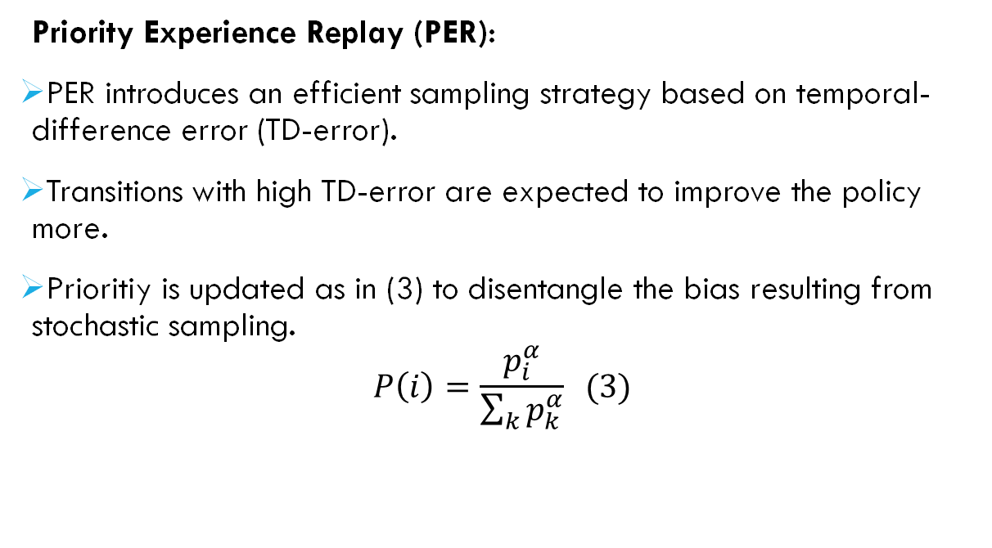
PER-DDQN
Priority Experience Replay (PER):
PER introduces an efficient sampling strategy based on temporal-difference error (TD-error).
Transitions with high TD-error are expected to improve the policy more.
Prioritiy is updated as in (3) to disentangle the bias resulting from stochastic sampling.
$$P\left(i\right)=\frac{p_{i}^{α}}{\sum_{k}{p_{k}^{α}}} (3)$$
T. Schaul, J. Quan, I. Antonoglou, and D. Silver, “Prioritized experience replay,” 2016.

Slide 5
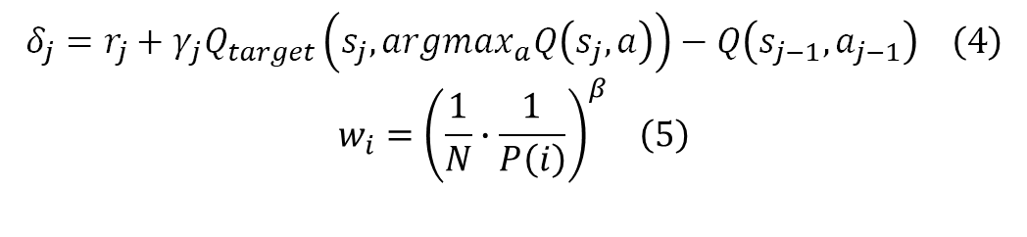
PER-DDQN
Priority Experience Replay (PER):
Temporal Difference (TD-error) is defined as in (4).
The loss is calculated using importance-sampling (individual weights to every transition) (5).
Intuitively, TD error shows how much current value estimate is different from this state for the current condition.
$$δ_{j}=r_{j}+γ_{j}Q_{target}\left(s_{j},argmax_{a}Q\left(s_{j},a\right)\right)−Q\left(s_{j−1},a_{j−1}\right) \left(4\right)$$
$$w_{i}={\left(\frac{1}{N}∙\frac{1}{P\left(i\right)}\right)}^{β} \left(5\right)$$
T. Schaul, J. Quan, I. Antonoglou, and D. Silver, “Prioritized experience replay,” 2016.

Slide 6
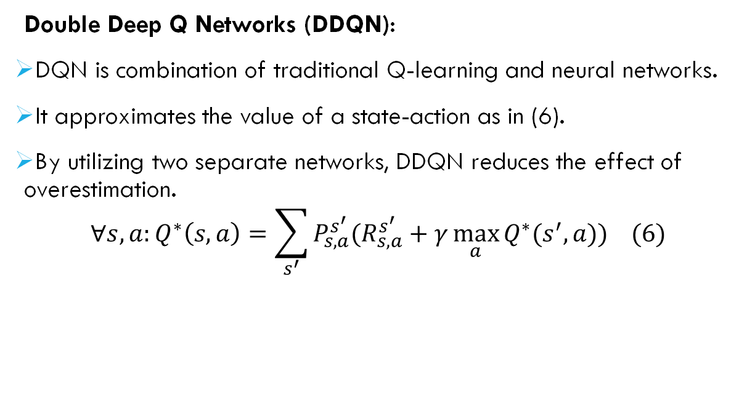
PER-DDQN
Double Deep Q Networks (DDQN):
DQN is combination of traditional Q-learning and neural networks.
It approximates the value of a state-action as in (6).
By utilizing two separate networks, DDQN reduces the effect of overestimation.
$$∀s,a:Q^{∗}\left(s,a\right)=\sum_{s^{′}}{P_{s,a}^{s^{′}}(R_{s,a}^{s^{′}}+γ\max_{a}{Q^{∗}(s^{′},a)) (6)}}$$
H. Van Hasselt, A. Guez, and D. Silver, “Deep reinforcement learning with double q-learning,” in Proceedings of the AAAI conference on artificial intelligence, vol. 30, no. 1, 2016.

Slide 7
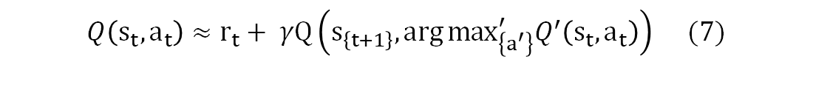
PER-DDQN
Double Deep Q Networks (DDQN):
DQN overestimates the values due to taking the maximum of another noisy estimate.
DDQN introduces a target network which slowly follows the online network.
Using two independent estimators disentangles the maximization bias.
It approximates the value of a state-action as in (7).
$$Q\left(s_{t},a_{t}\right)≈r_{t}+ γQ\left(s_{\left\{t+1\right\}},\arg{\max_{\left\{a^{′}\right\}}^{′}Q^{′}\left(s_{t},a_{t}\right)}\right) (7)$$
H. Van Hasselt, A. Guez, and D. Silver, “Deep reinforcement learning with double q-learning,” in Proceedings of the AAAI conference on artificial intelligence, vol. 30, no. 1, 2016.

Slide 8

TD3
Twin Delayed DDPG (TD3) is the successor of DDPG (Deep Deterministic Policy Gradient) method which can operate on continuous action spaces.
TD3 proposes two independent critic networks to eliminate the overestimation bias in DDPG.
By taking the minimum of two value estimates, additional overestimation is removed (8).
$$y_{i}=r+γ\min_{i=1,2}{Q_{θ_{i}^{′}}(s^{′}, π_{φ_{1}}\left(s^{′}\right))} (8)$$
S. Fujimoto, H. van Hoof, and D. Meger, “Addressing Function Approximation Error in Actor-Critic Methods,” arXiv e-prints, p. arXiv:1802.09477, Feb. 2018.

Slide 9
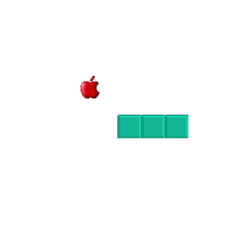
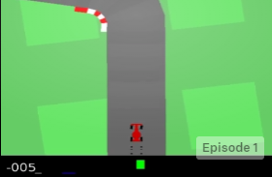
Envıronments
We chose two environments to implement state-of-the-art algorithms.
We trained a PER-DDQN agent on traditional Snake Game environment (discrete action space).
We trained a TD3 agent on CarRacing-v0 environment.

Slide 10

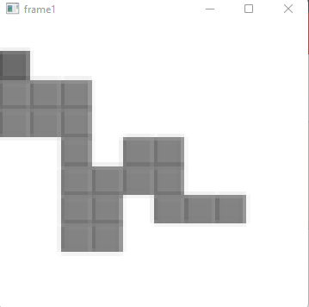

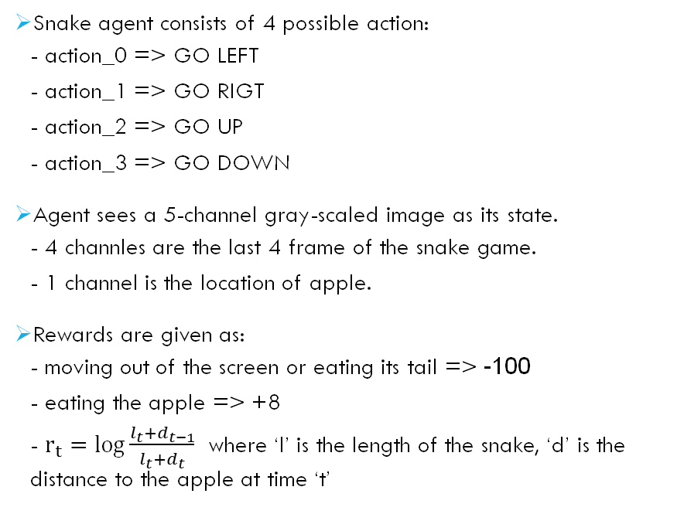
Envıronments Snake game
Snake agent consists of 4 possible action:
- action_0 => GO LEFT
- action_1 => GO RIGT
- action_2 => GO UP
- action_3 => GO DOWN
Agent sees a 5-channel gray-scaled image as its state.
- 4 channles are the last 4 frame of the snake game.
- 1 channel is the location of apple.
Rewards are given as:
- moving out of the screen or eating its tail => -100
- eating the apple => +8
- $r_{t}=\log{\frac{l_{t}+d_{t−1}}{l_{t}+d_{t}}}$ where ‘l’ is the length of the snake, ‘d’ is the distance to the apple at time ‘t’

Slide 11




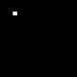
Envıronments Snake game
Snake agent sees 5 channel gray-scaled image:
$frame_{t−3} frame_{t−2}$ $frame_{t−1}$ $frame_{t} apple_{t}$

Slide 12
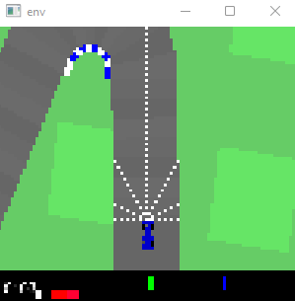
Envıronments car racıng
CarRacing-v0 agent has 2 continuous actions.
- Acceleration-Brake (-1,1)
- Steering (-1,1)
CarRacing-v0 agent has 13 dimensional state vector.
- 7 normalized lidar distances
- car position angle
- car angular damping
- car angular velocity
- car linear velocity on x direction
- car linear velocity on y direction
- car linear damping
Rewards are defined as:
- -0.1 for every step (to encourage faster driving)
- -100 if car is out of track

Slide 13
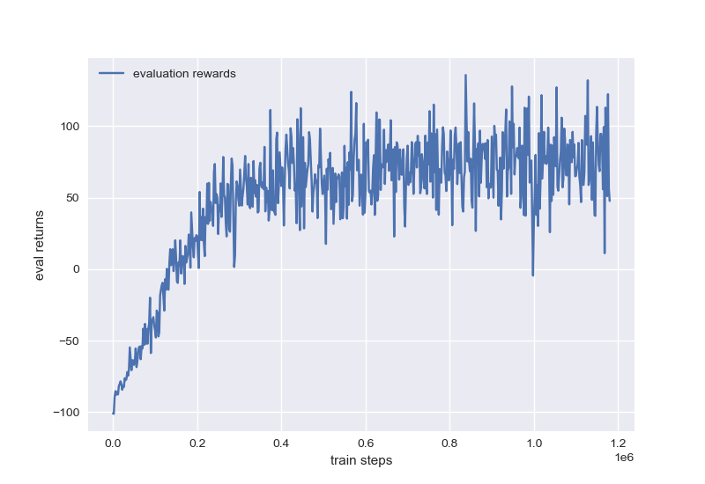
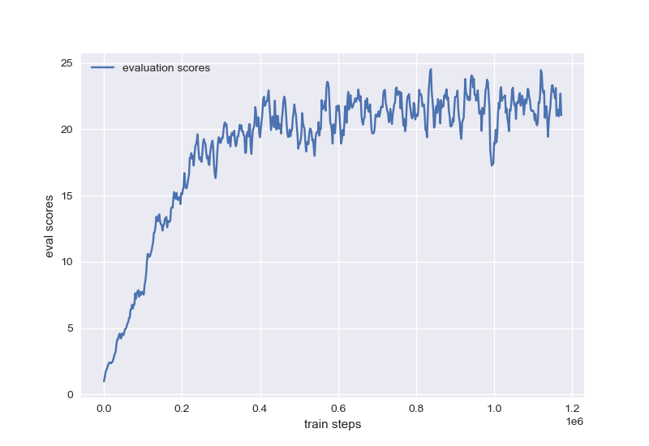
Results snake game
Figure 1: Evaluation returns for every 2000 steps during training
Figure 2: Evaluation scores (number of apples eaten) for every 2000 steps during training

Slide 14
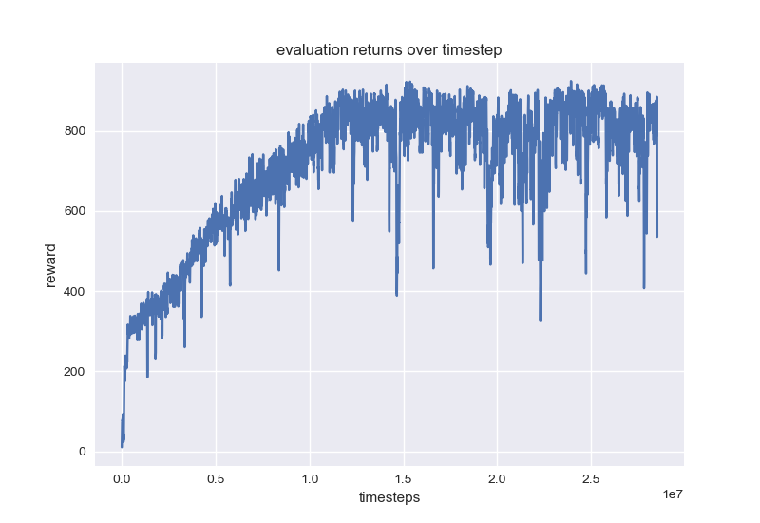
Results car racıng
Figure 3: evaluation returns for every 3000 steps during training.

Slide 15

Snake game

Slide 16
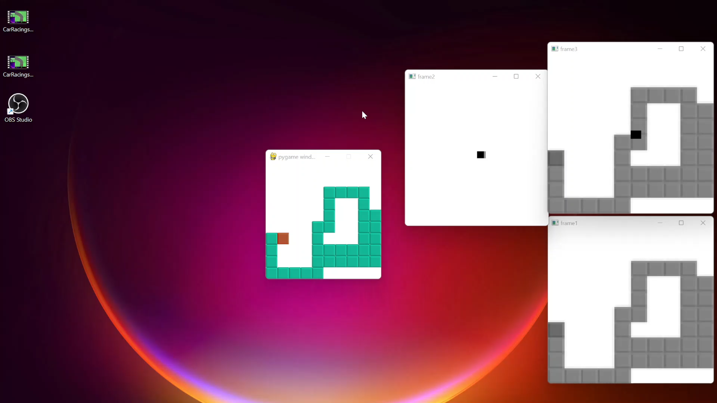
Snake game

Slide 17
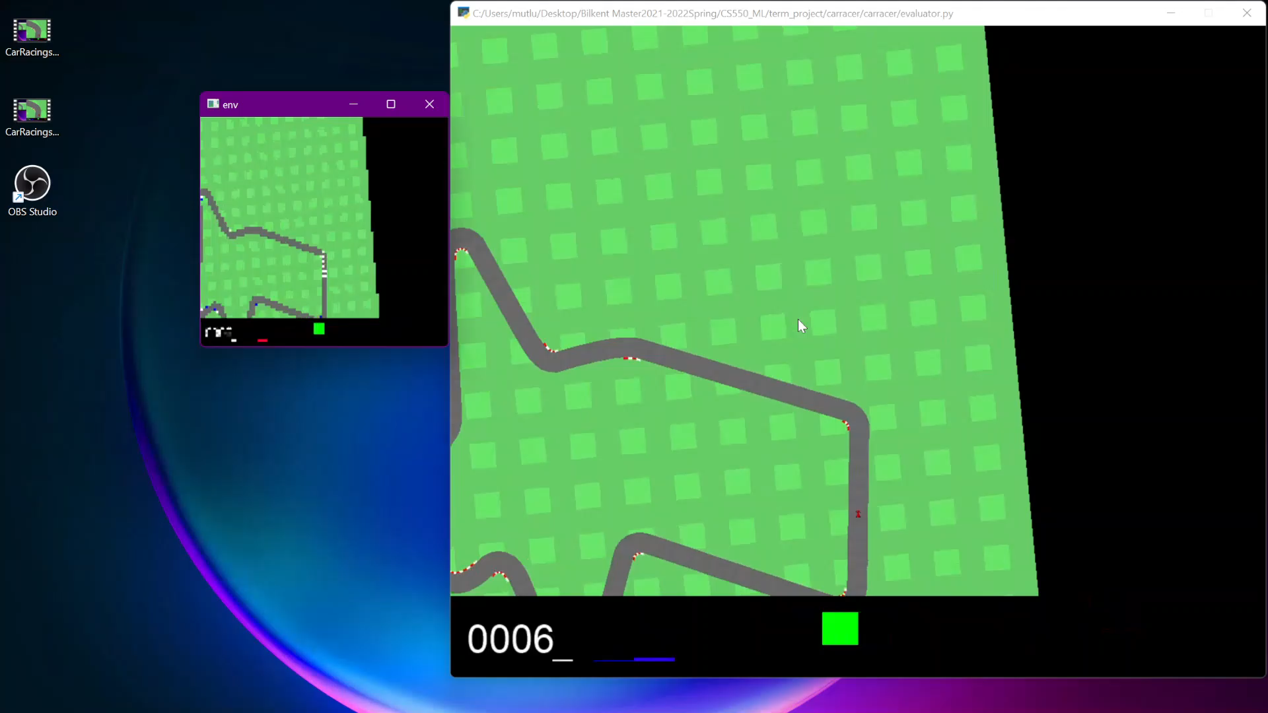
Car racıng

Slide 18
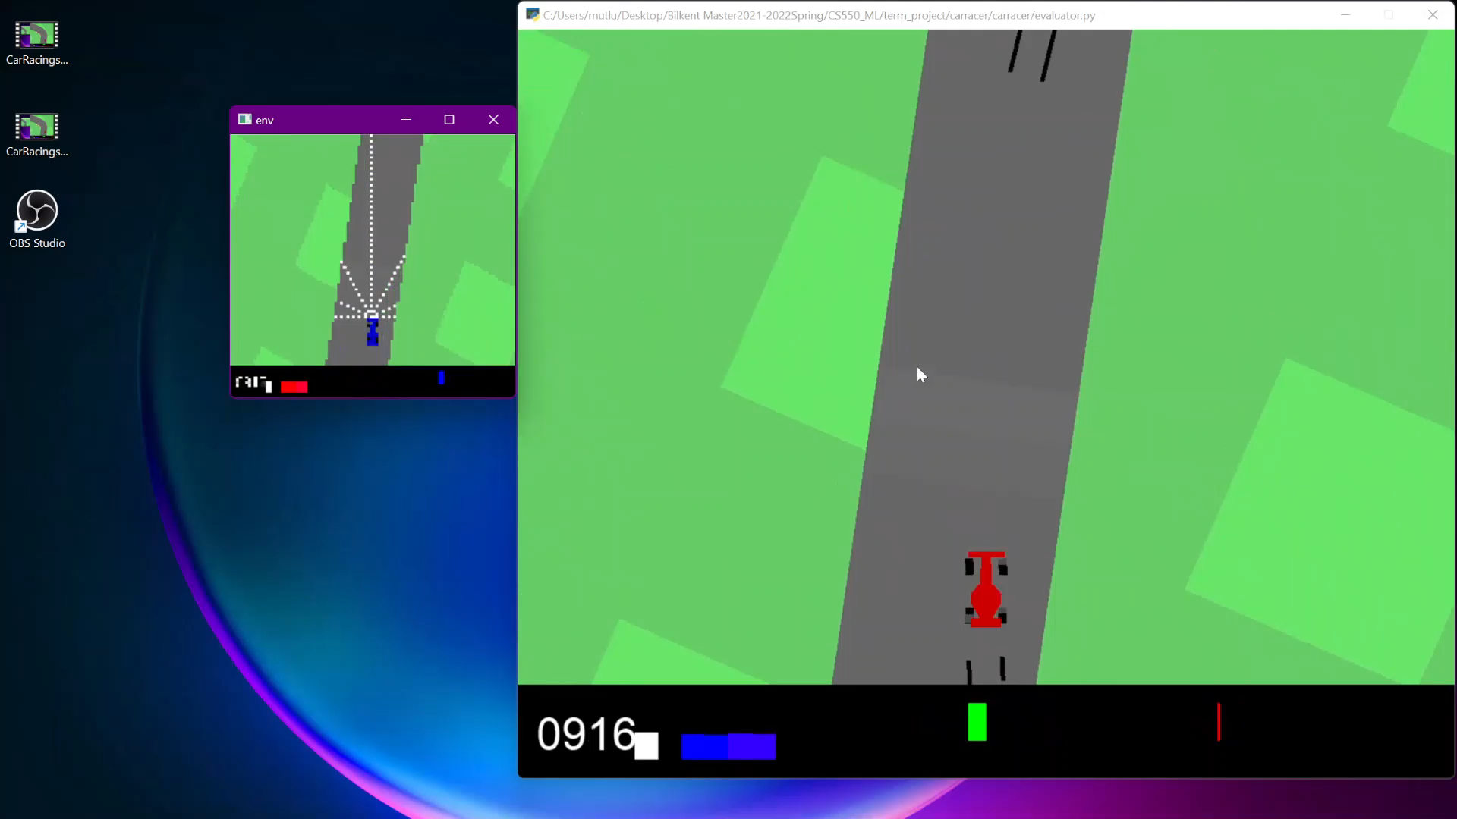
Car racıng

Slide 19
Thank you

